Slide 1
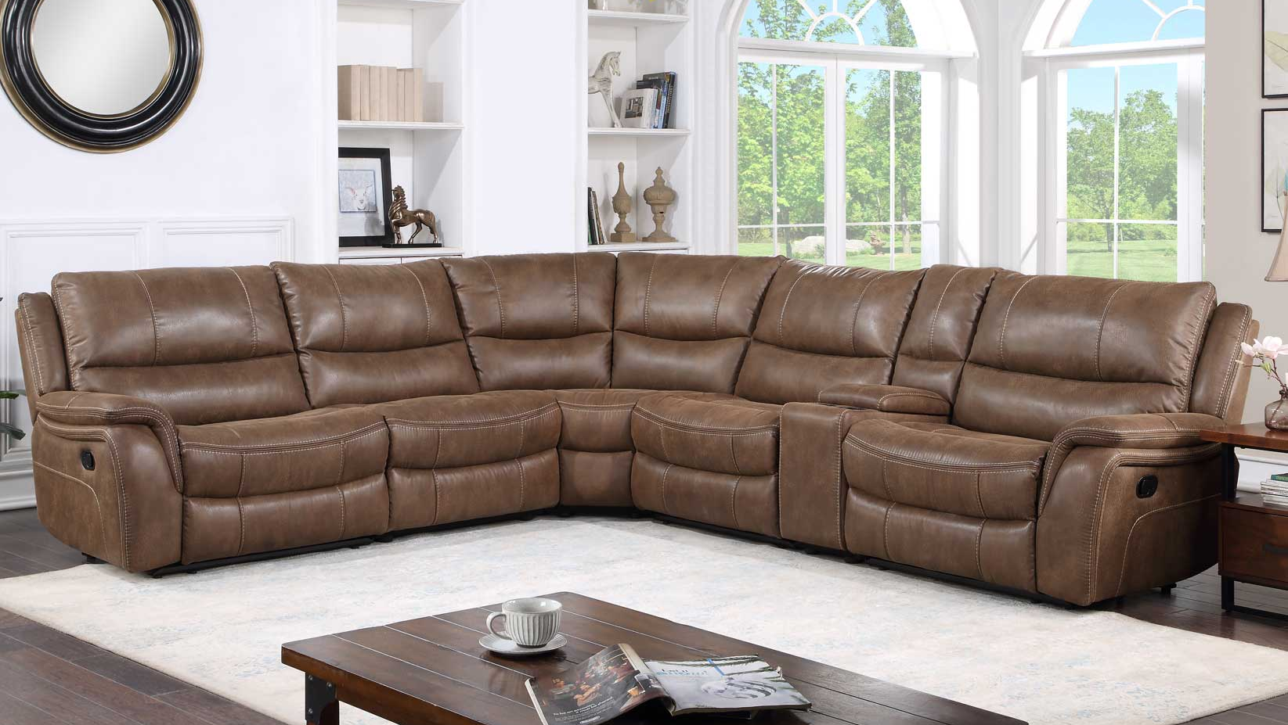
CM COLLECTION

Slide 2
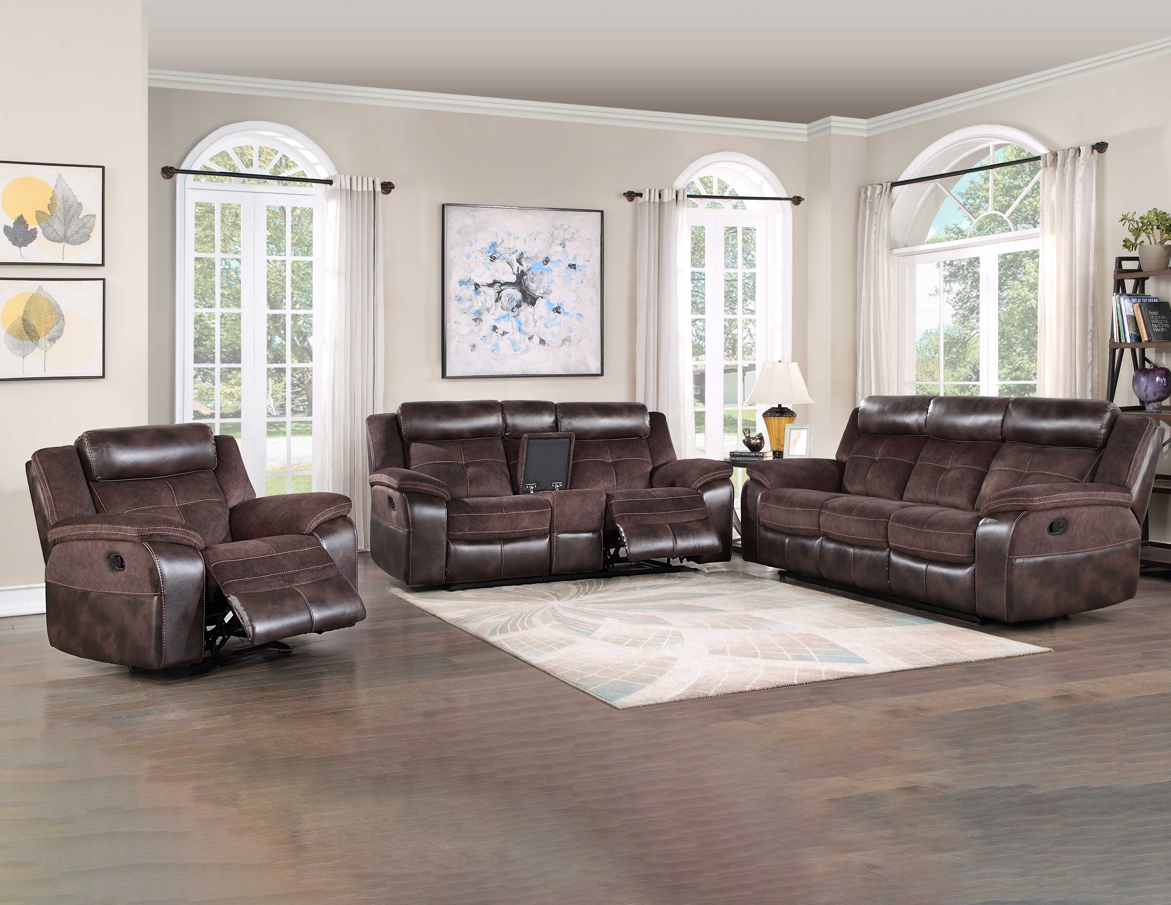
Pueblo
You are sure to turn heads with the stylish and functional design of Pueblo. A contrasting fabric and leatherette cover looks great and offers added protection from high traffic areas.
Manual recline
Easy-care leatherette on headrest and footrest offer added protection for heavy use area in a stylish two-tone fabric application
Loveseat features a lift-top console and two cupholders
Coffee fabric and leatherette
Available as Mixable Truckload Purchase only
Item | Description | Cubes | WH Price
UE9222SC | Pueblo Recliner Sofa Two tone, 91"x39"x42.5" | 53.72 | $529.00
UE9222CLC | Pueblo Recliner Console Loveseat, Two Tone, 77.2"x39"x42.5" | 48.40 | $529.00
2 Piece | Pueblo Recliner Sofa and Loveseat | 102.12 | $1,058.00
UE9222RC | Pueblo Recliner Chair, Two-Tone, 26.75"x39"x42.5" | 26.56 | $279.00
3 Piece | Pueblo Recliner Sofa, Loveseat & Chair | 128.68 | $1,337.00

Slide 3
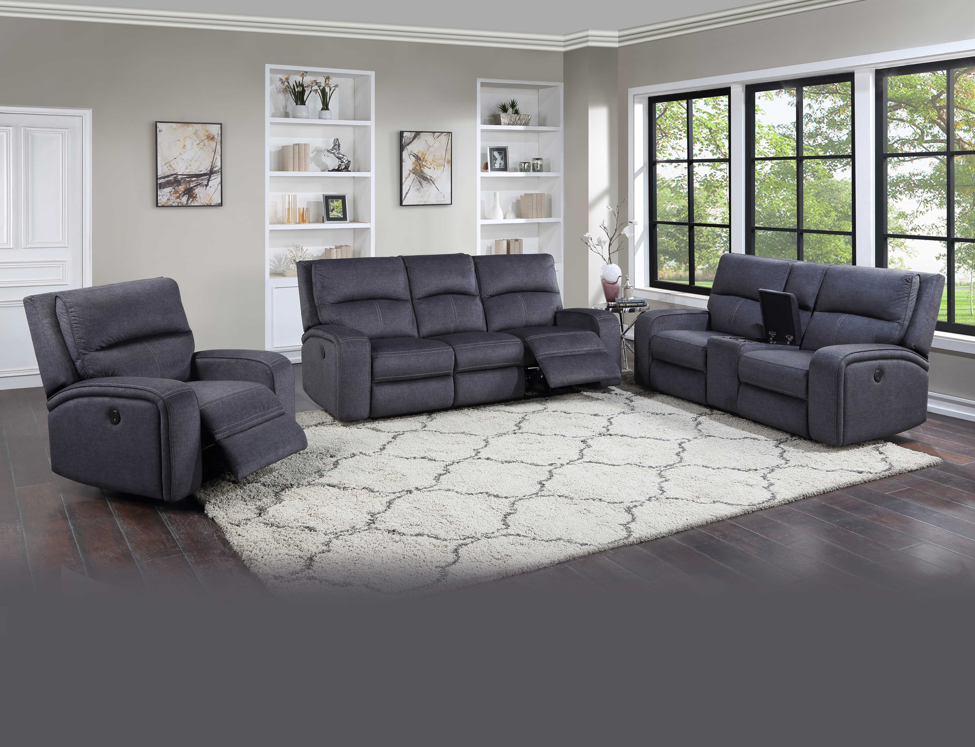
Lovell
A power reclining set, Lovell offers incredible comfort in a classically styled motion group. Power footrest operates at the touch of a button while the intricate stitching covers all the details.
Power Footrest
Plush wide seating area
USB charging port
Charcoal fabric
Available as Mixable Truckload Purchase only
Item | Description | Cubes | WH Price
LO5168SC | Lovell Power Recliner Sofa, 87"x42"x42" | 66.61 | $629.00
LO5168CLC | Lovell Power Recliner Console Loveseat, 65"x42"x42" | 60.00 | $629.00
2 Piece | Lovell Recliner Sofa and Loveseat | 126.61 | $1,258.00
LO5168RC | Lovell Power Reclining Chair 41"x42"x42 | 31.39 | $299.00
3 Piece | Lovell Recliner Sofa, Loveseat & Chair | 158.00 | $1,557.00

Slide 4
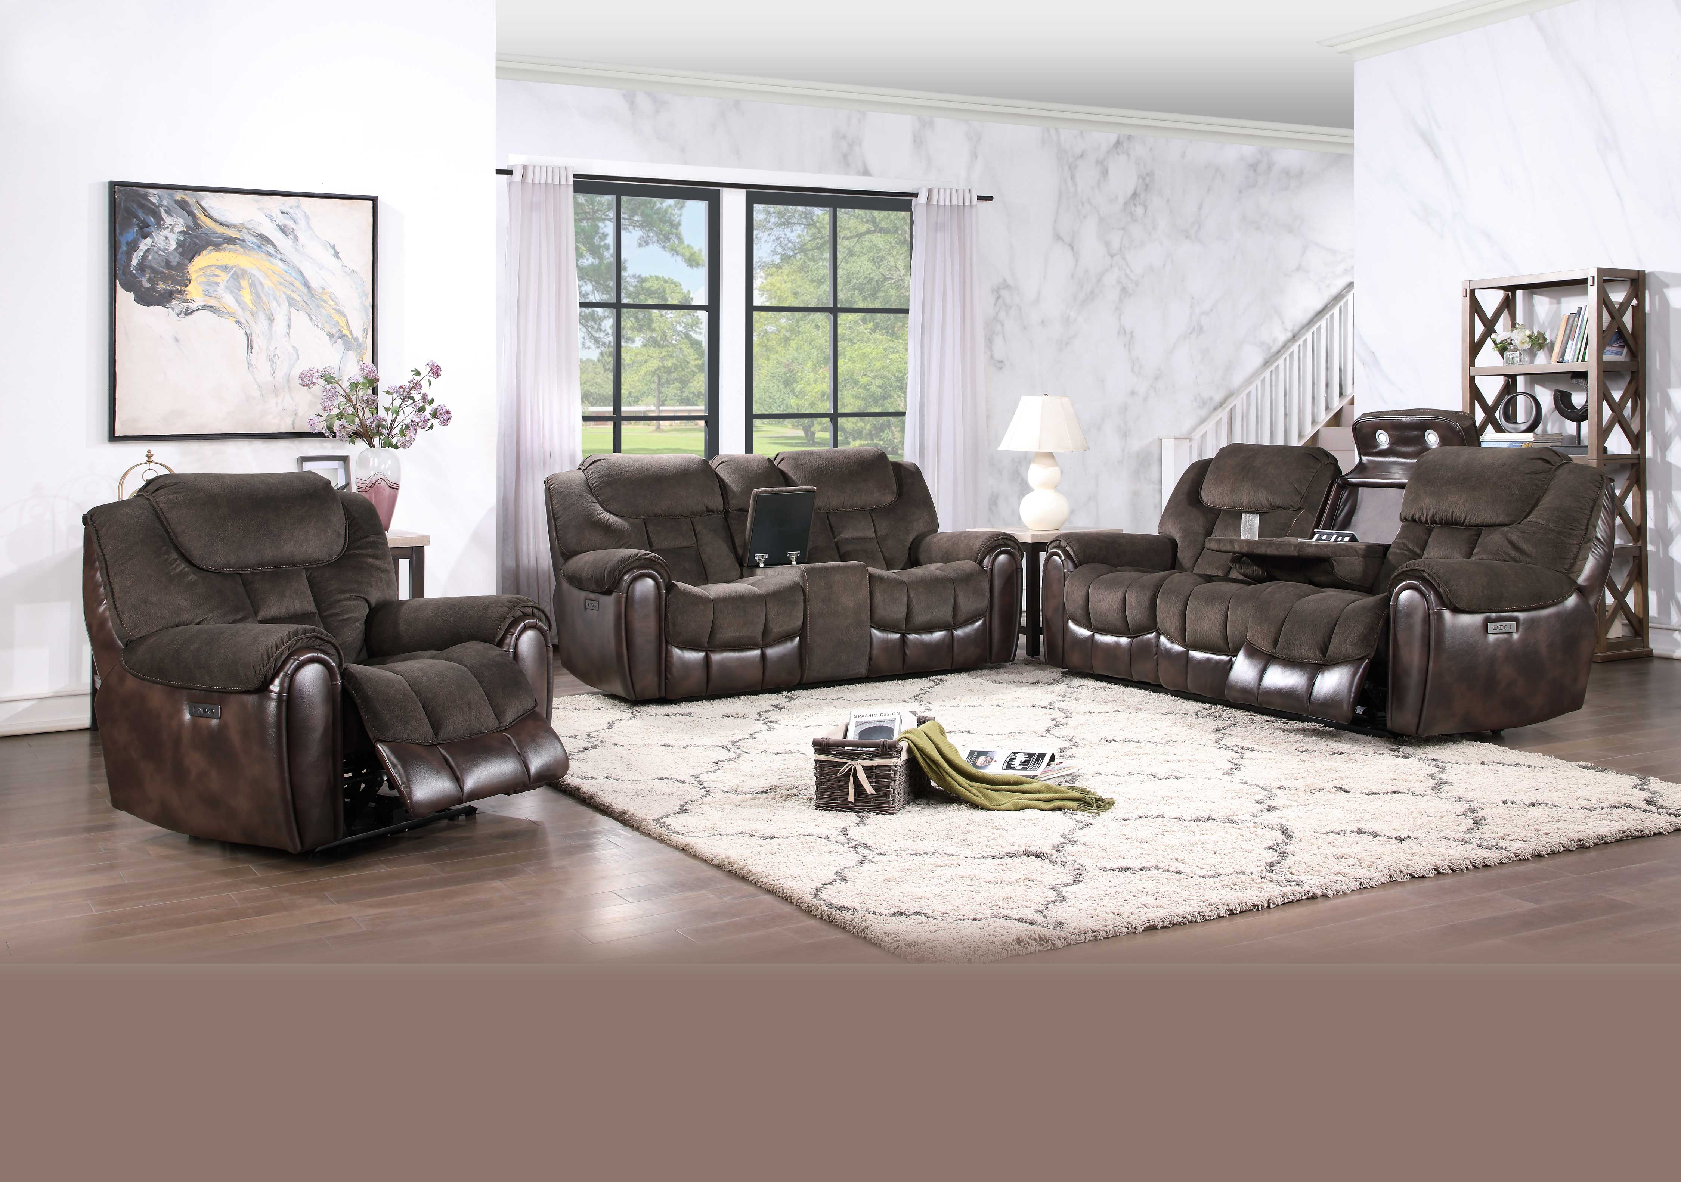
Apollo
Apollo is a two-tone reclining stunner with a deep merlot fabric and leatherette combination that is as practical as it is beautiful. The real star of this 3-piece set is the Sofa with a Dropdown Console that will quickly become the hub of any living room.
Dual-Power (Power Headrest and Power Footrest)
Plush wide seating area
Dropdown Sofa Console has 2 cupholders, a pop-up electrical panel with 2 outlets, 2 USB chargers and 2 lights.
Deep Merlot fabric with leatherette on footrests, sides and backs
Available as Mixable Truckload Purchase only
Item | Description | Cubes | WH Price
AP70039SE | Apollo Power/Power Recliner w/drop down table (lights), Sofa, 90"x41"x41.5" | 70.50 | $695.00
AP70039CLE | Apollo Power/Power Recliner Console Loveseat, 79"x41"x41.5" | 61.98 | $695.00
2 Piece | Apollo Recliner Sofa and Loveseat | 132.48 | $1,390.00
AP70039RE | Apollo Power/Power Reclining Chair 43"x41"x41.5" | 34.09 | $369.00
3 Piece | Apollo Recliner Sofa, Loveseat & Chair | 166.57 | $1,759.00

Slide 5
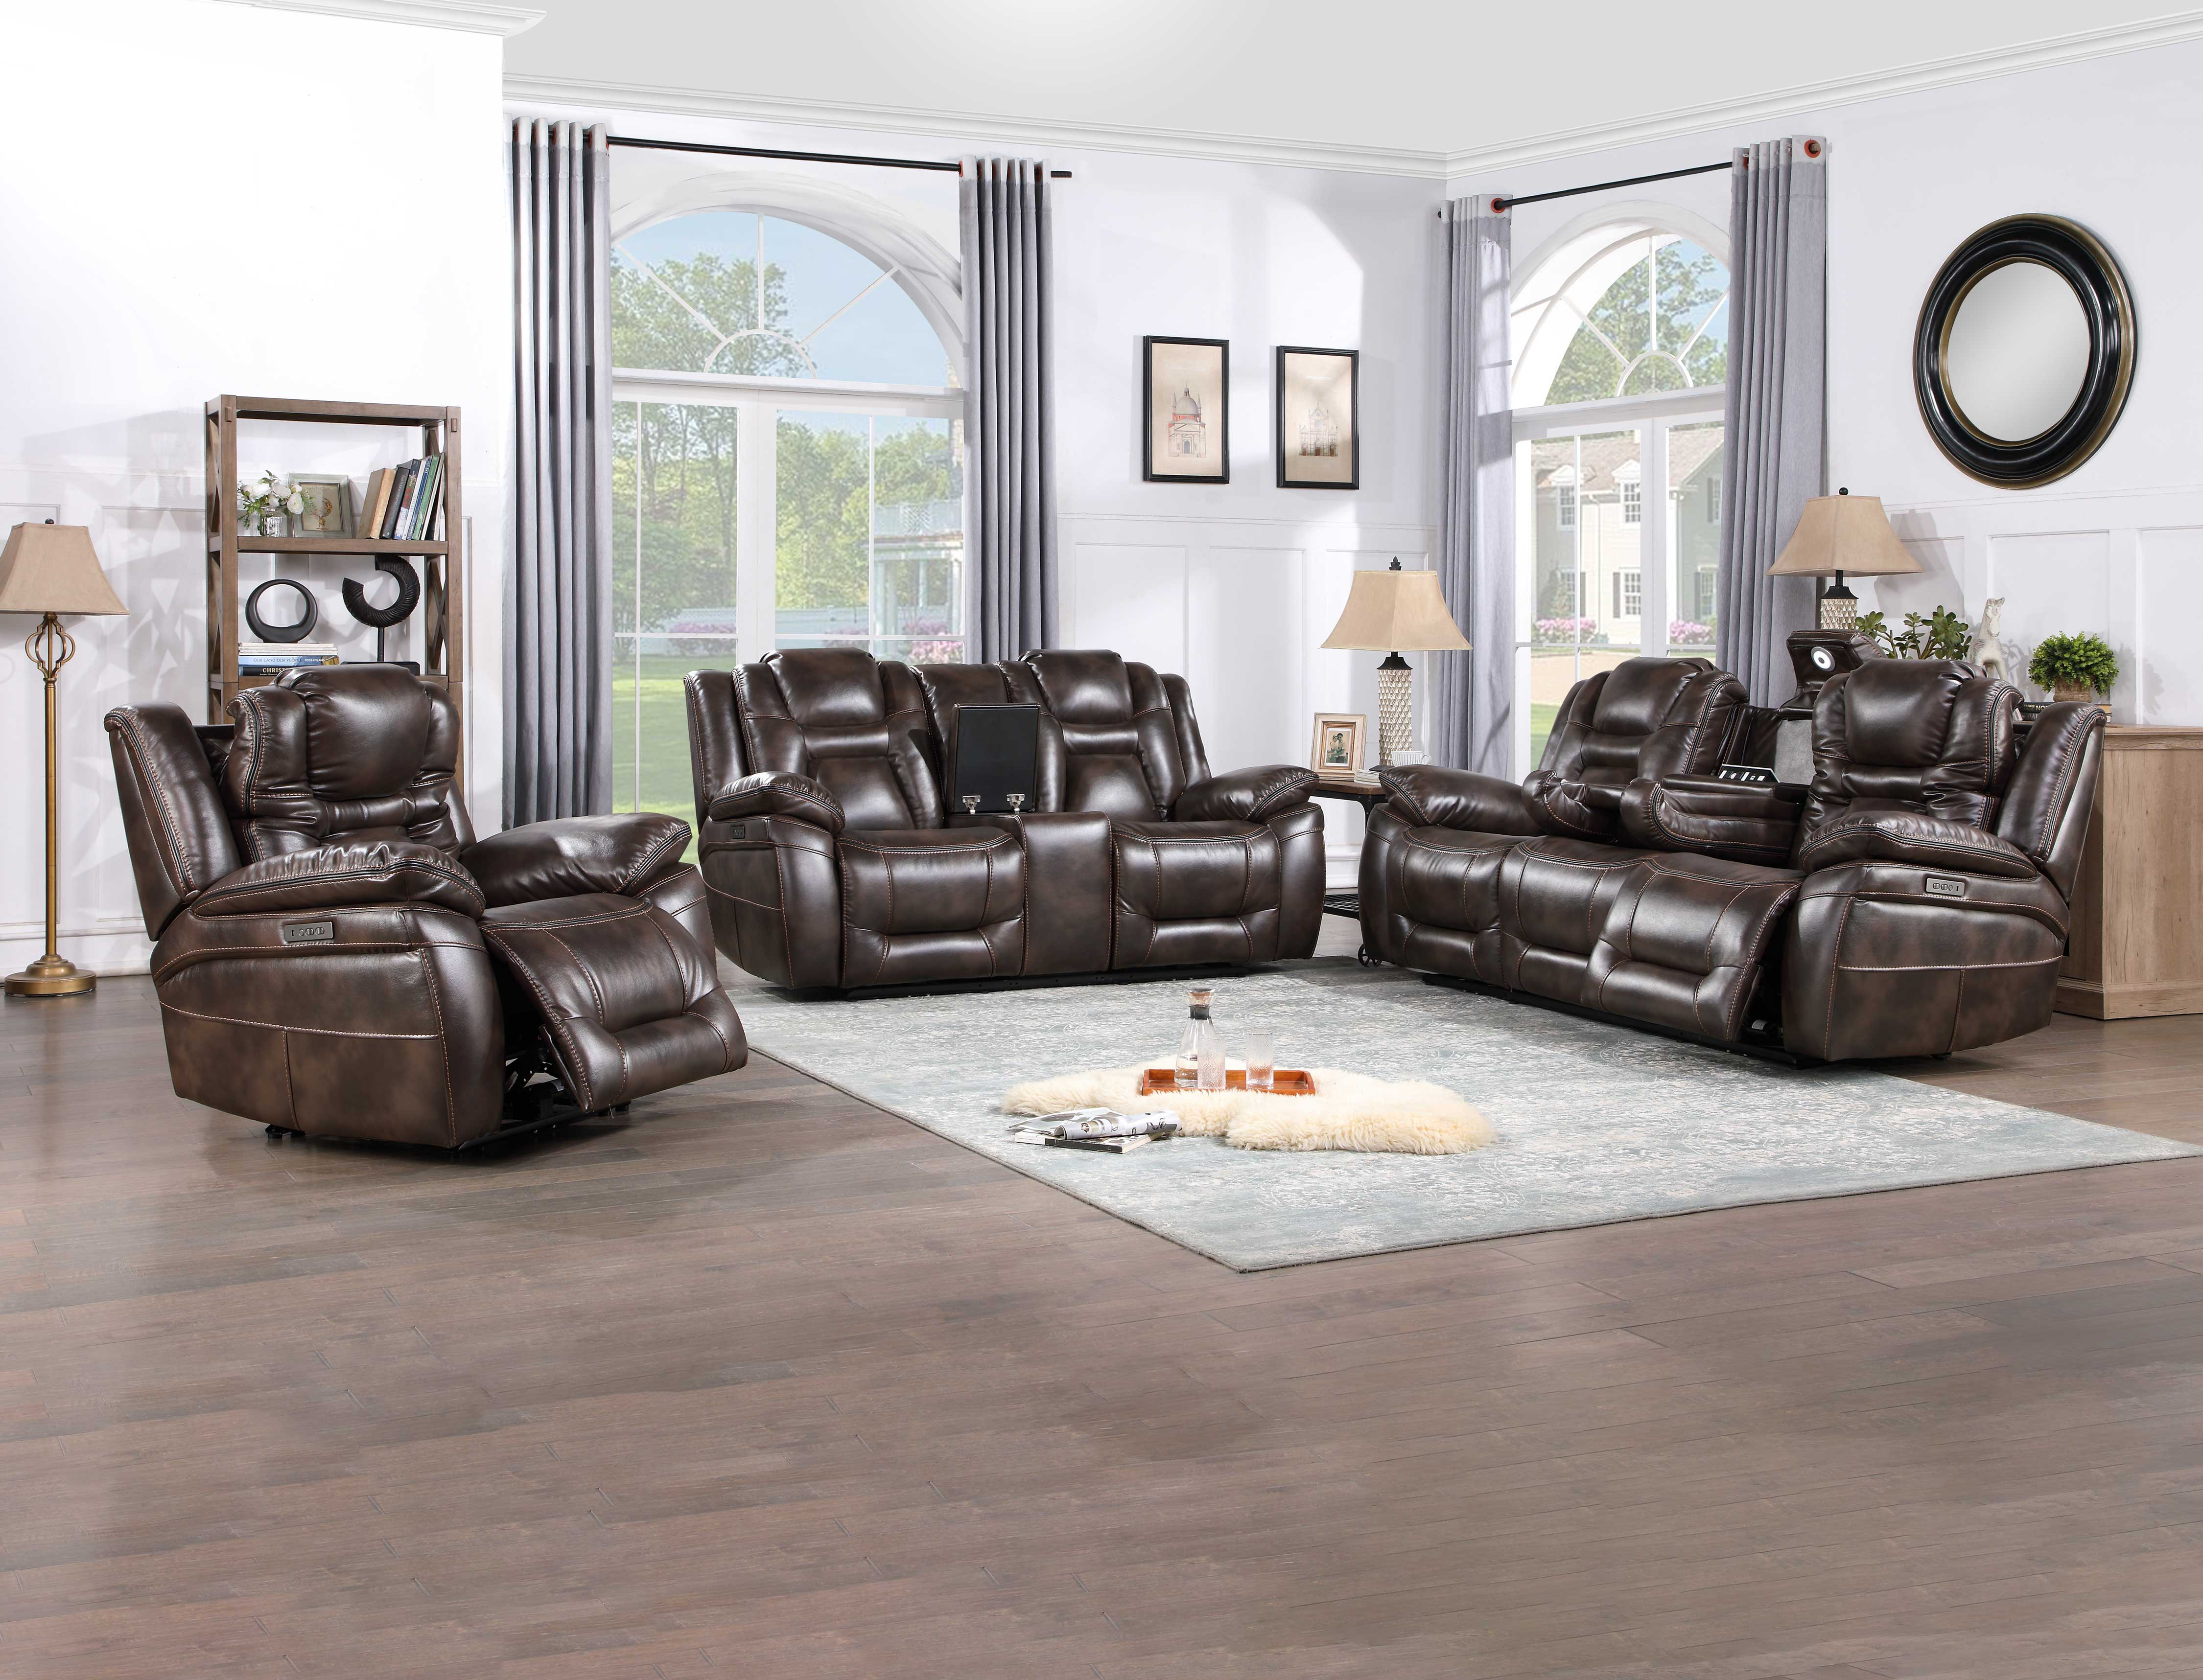
Oportuna
Start your engines with the Dual-Power Oportuna motion group. Elaborate padding and stitching give your seat the look and feel of a race car right in your living room. Draped in beautiful coffee leatherette, this group also has all the bells and whistles you crave with a Dropdown console that serves as the hub of your living room.
Dual-Power (Power Headrest and Power Footrest)
Plush wide seating area
Dropdown Sofa Console has 2 cupholders, a pop-up electrical panel with 2 outlets, 2 USB chargers and a light.
Coffee Leatherette
Available as Mixable Truckload Purchase only
Item | Description | Cubes | WH Price
OP70061SC | Oportuna Power/Power Recliner Sofa w/drop down table (lights) 89"x40"x41.5" | 54.69 | $799.00
OP70061CLC | Oportuna Power/Power Recliner Console Loveseat, 79"x40"x41.5" | 48.61 | $799.00
2 Piece | Oportuna Recliner Sofa and Loveseat | 103.30 | $1,598.00
OP70061RC | Oportuna Power/Power Reclining Chair 40.5"x40"x41.5" | 26.74 | $379.00
3 Piece | Oportuna Recliner Sofa, Loveseat & Chair | 130.04 | $1,977.00

Slide 6
Lehi
Comfort, convenience and style blend beautifully in the six-piece Lehi modular Sectional. Covered in a warm brindle-colored breathable leatherette, the Lehi features luxurious shaped seats with contrasting stitching for a seat as good-looking as it is comfortable. The manual footrest opens easily with the pull-lever control and the Lift-Top Console adds storage and USB charging ports for a central hub for all your electronics.
Manual Footrest
Modular Configuration to easily fit any space
Plush wide seating area
360 lb. weight capacity
Brindle Leatherette
Item | Description | Cubes | WH Price
LH9750LRB | Lehi LAF Manual Recliner, Brindle 41.5 x 38 x 39.5 | 26.42 | $250.00
LH9750ACB | Lehi Armless Chair, Brindle 32.5 x 38 x 39.5 | 20.25 | $160.00
LH9750WB | Lehi Wedge, Brindle, 63 x 39.75 x 39.5 | 36.54 | $229.00
LH9750ARB | Lehi Armless Recliner, Brindle, 32.5 x 38 x 39.5 | 20.25 | $190.00
LH9750CB | Lehi Console w/Power, Brindle, 13 x 38 x 39.5 | 9 | $90.00
LH9750RRB | Lehi RAF Manual Recliner, Brindle, 41.5 x 38 x 39.5 | 26.72 | $250.00
6 Piece | Lehi Manual Sectional with one Armless and one Arm Chair and Console | 169.74 | $1,169.00

Slide 7
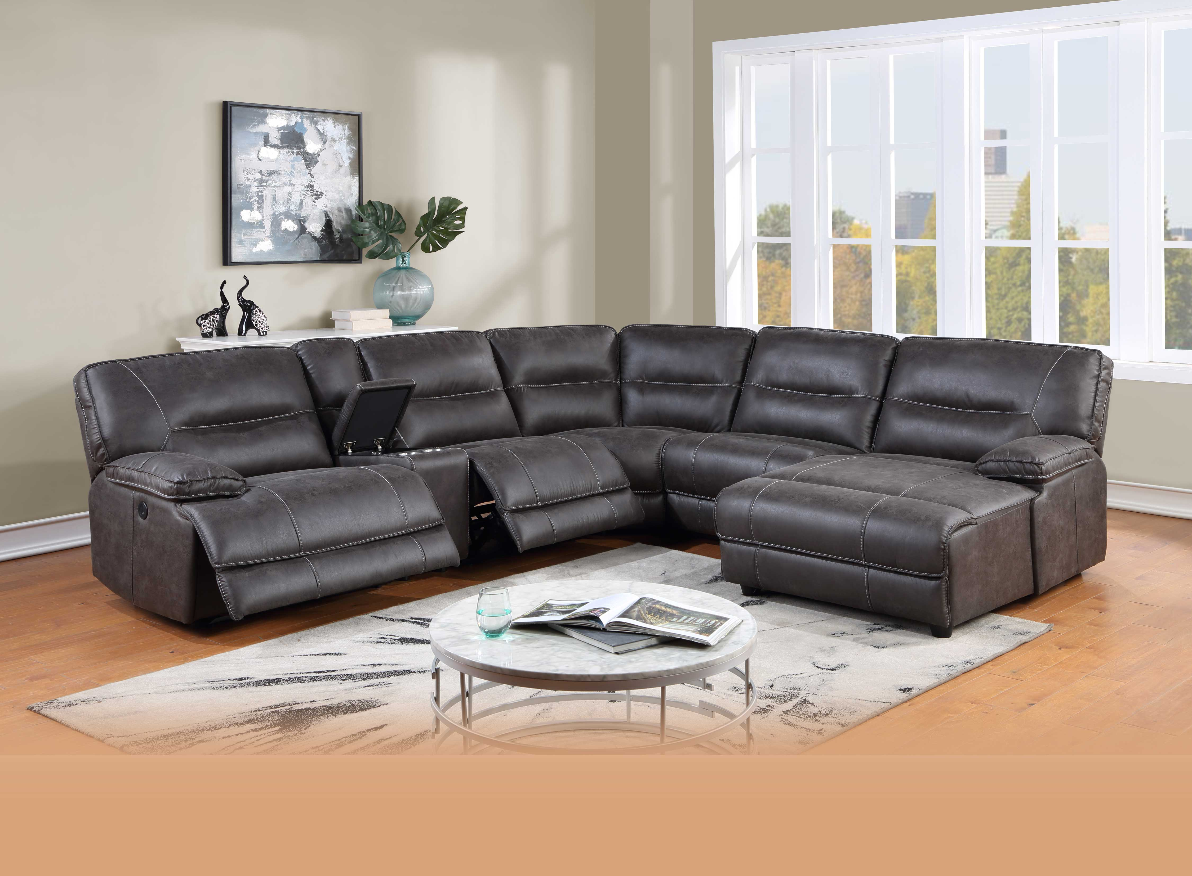
Ogden
Modular seating and ultra-wide seats are just the beginning for this reclining sectional. Ogden can be used as a traditional sectional or configured with a Chaise end for a super comfortable setting.
Power Footrest
Modular Configuration to easily fit any space
Plush wide seating area
USB charging port
Granite Leatherette
Available as Mixable Truckload Purchase only
Item | Description | Cubes | WH Price
OG5150LRG | Ogden LAF Recliner, Power, 41"x40.5"x39" | 30.26 | $340.00
OG5150CHG | Ogden RAF Chaise, 41.5"x65"x41" | 46.67 | $350.00
OG5150ARG | Ogden Armless Recliner, Power, 32"x40.5"x39" | 23.78 | $290.00
OG5150ACG | Ogden Armless Chair, 32"x40.5"x39" | 23.78 | $170.00
OG5150WG | Ogden Corner Wedge, 44"x44"x39" | 35.16 | $269.00
OG5150CG | Ogden Straight Console, Electric, 13"x40.5"x39" | 10.09 | $110.00
6 Piece | Ogden Sectional w/2 Power Recliners & Chaise | 169.74 | $1529.00

Slide 8
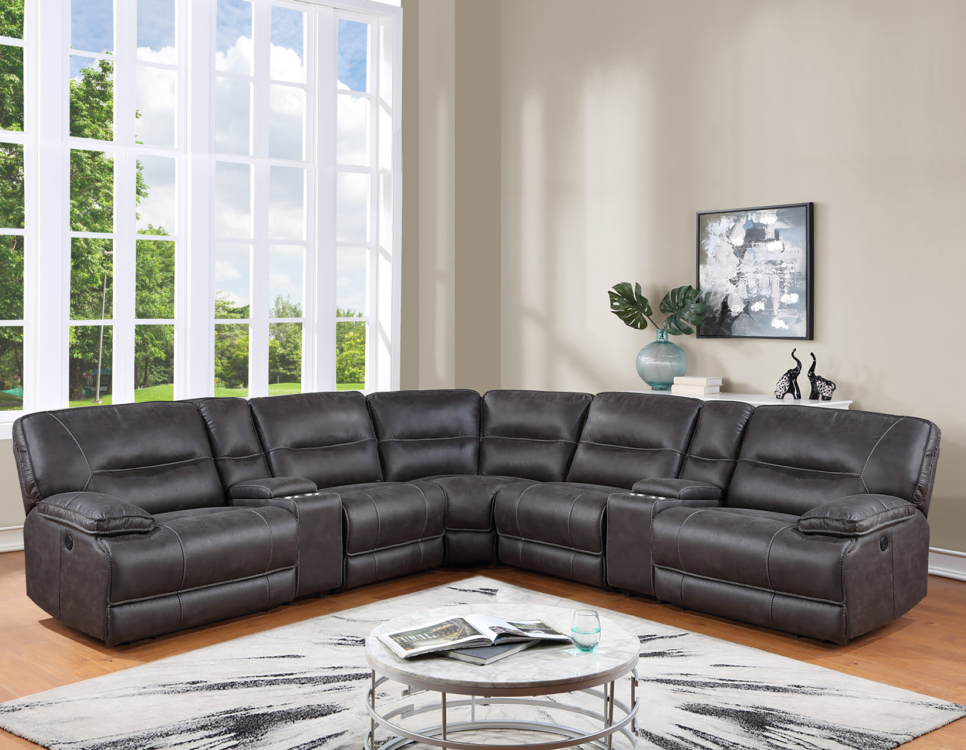
Ogden
Modular seating and ultra-wide seats are just the beginning for this reclining sectional. Ogden can be used as a traditional sectional or configured with a Chaise end for a super comfortable setting.
Power Footrest
Modular Configuration to easily fit any space
Plush wide seating area
USB charging port
Granite Leatherette
Available as Mixable Truckload Purchase only
Item | Description | Cubes | WH Price
OG5150LRG | Ogden LAF Recliner, Power, 41"x40.5"x39" | 30.26 | $340.00
OG5150RRG | Ogden RAF Recliner, 41” x 40.5"x 39" | 30.26 | $350.00
OG5150ARG | Ogden Armless Recliner, Power, 32"x40.5"x39" | 23.78 | $290.00
OG5150ACG | Ogden Armless Chair, 32"x40.5"x39" | 23.78 | $170.00
OG5150WG | Ogden Corner Wedge, 44"x44"x39" | 35.16 | $269.00
OG5150CG | Ogden Straight Console, Electric, 13"x40.5"x39" | 10.09 | $110.00
6 Piece | Ogden Sectional, AC, AR & RAF Recliner | 153.33 | $1,529.00

Slide 9
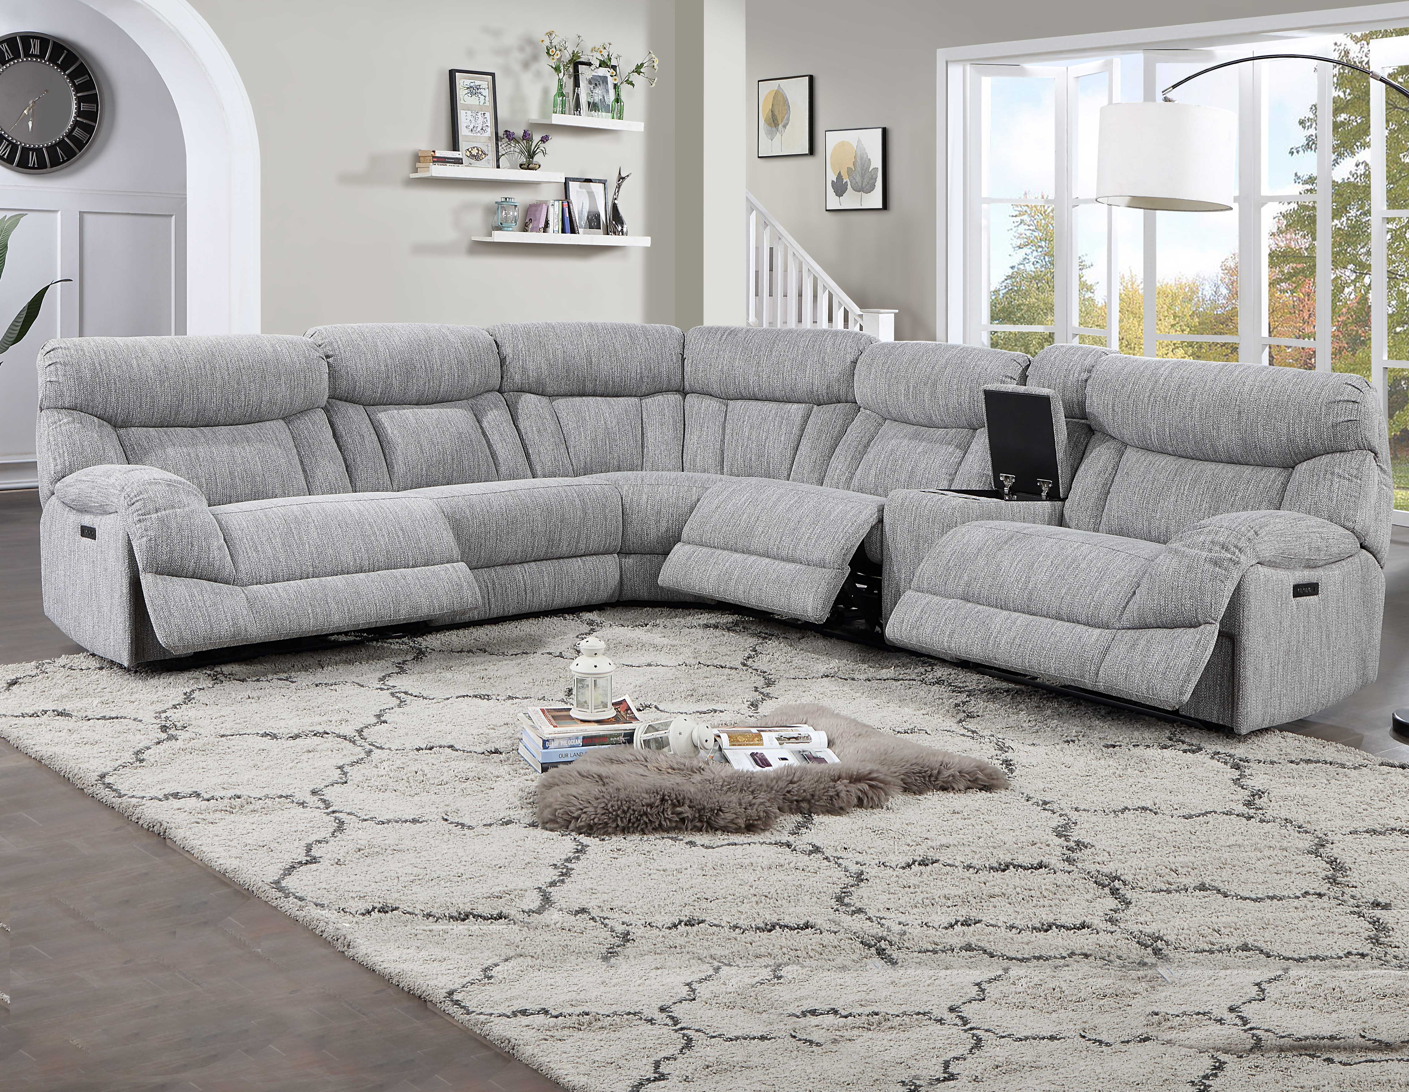
Park City
Modular seating for a large or smaller group, Provo sports transitional styling in a pumice chenille application. Ultra-wide seating makes for extra comfort and each seat is sold separately to fit your space exactly.
Dual-Power (Power Headrest and Power Footrest)
Modular Configuration to easily fit any space
Plush wide seating area
Pumice chenille fabric
Available as Mixable Truckload Purchase only
Item | Description | Cubes | WH Price
AR70172LRP | Park City LAF Recliner, Power/Power, 42"x41.5"x41" | 34.09 | $350.00
AR70172RRP | Park City RAF Recliner, Power/Power, 42"x41.5"x41" | 34.09 | $350.00
AR70172ARP | Park City Armless Recliner, Power/Power, 32"x40.5"x41" | 24.96 | $270.00
AR70172ACP | Park City Armless Chair, 32"x40.5"x41" | 24.96 | $180.00
AR70172WP | Park City Corner Wedge, 49"x49"x41" | 42.19 | $349.00
AR70172CEP | Park City Straight Console, Electric, 13"x40.5"x41" | 10.59 | $100
6 Piece | Park City Sectional w/3 Power/Power Recliners, 1 console | 170.88 | $1,599.00
7 Piece | Park City Sectional w/3 Power/Power Recliners, 2 consoles | 181.47 | $1,699.00

Slide 10
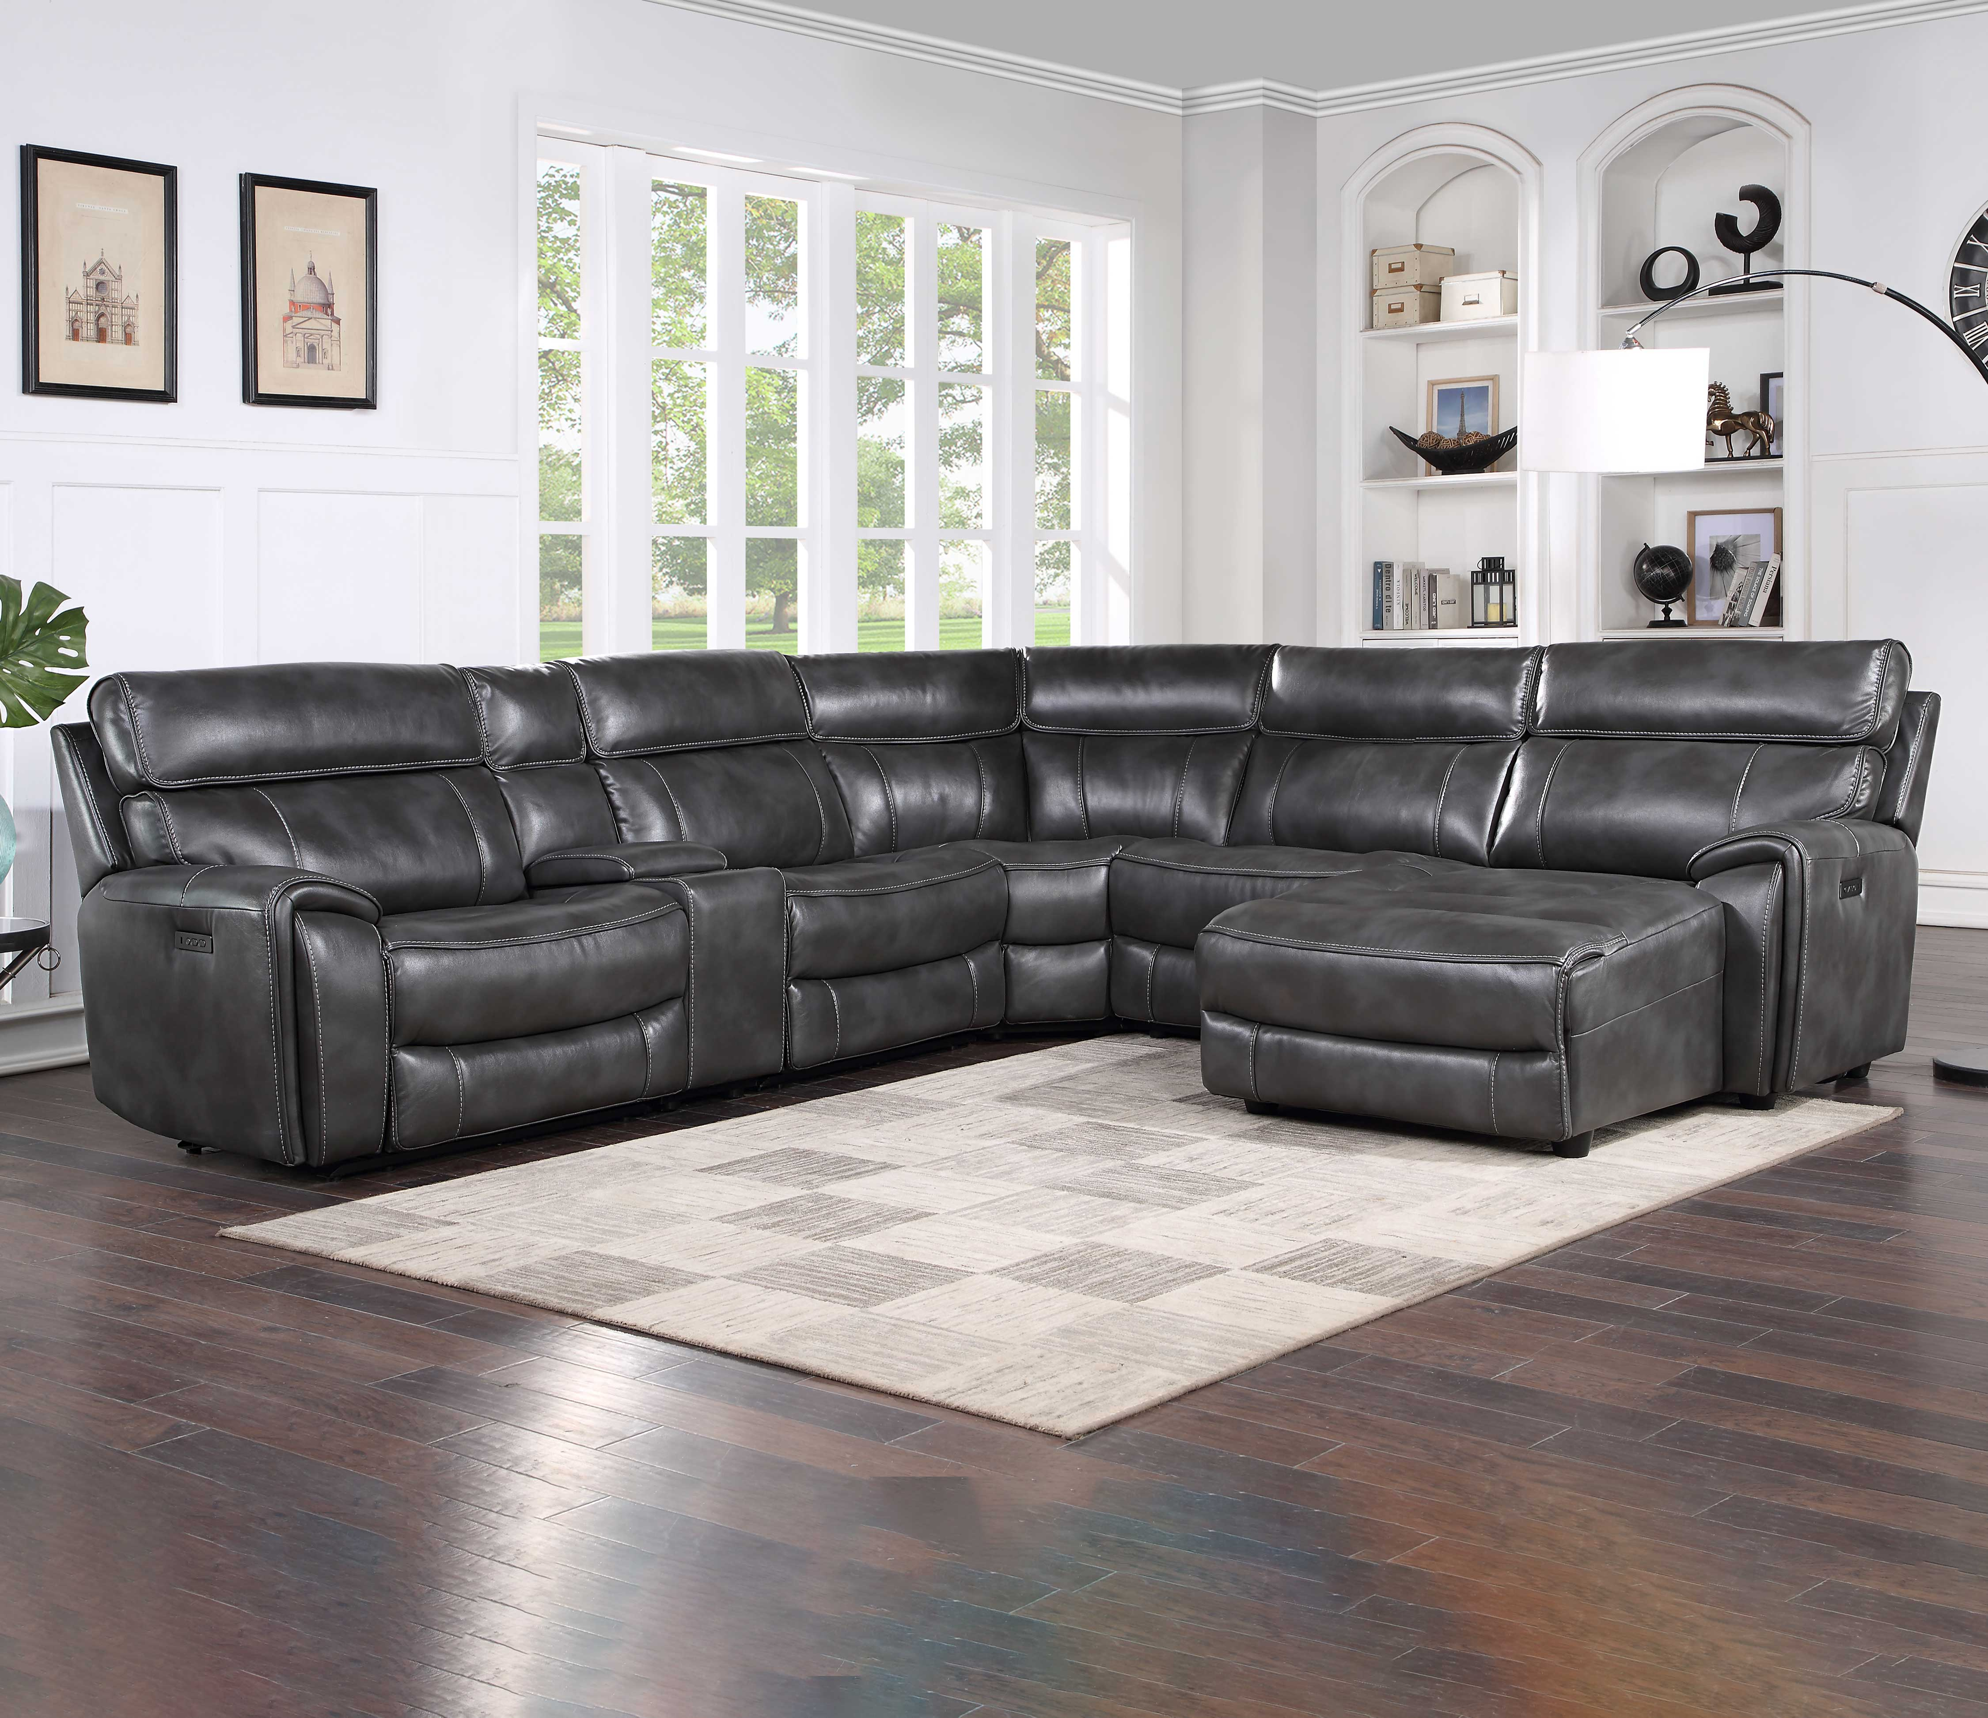
Provo
Modular seating for a large or smaller group, Provo sports transitional styling in a slate leatherette. Ultra-wide seating makes for extra comfort and each seat is sold separately to fit your space exactly.
Dual-Power (Power Headrest and Power Footrest)
Modular Configuration to easily fit any space
Plush wide seating area
USB charging port
Slate Leatherette
Available as Mixable Truckload Purchase only
Item | Description | Cubes | WH Price
OV5781LRS | Provo LAF Recliner, Power/Power, 41.5"x39"x39" | 28.76 | $380.00
OV5781RRS | Provo RAF Chaise Recliner, Power/Power, 41.5"x65"x39" | 46.84 | $520.00
OV5781ARS | Provo Armless Recliner, Power/Power, 32"x39"x39" | 20.1 | $300.00
OV5781ACS | Provo Armless Chair, 32"x39"x39" | 20.1 | $190.00
OV5781WS | Provo Corner Wedge, 46"x46"x46" | 41.93 | $299.00
OV5781CS | Provo Straight Console, Electric, 13"x39"x39" | 9.09 | $110.00
6 Piece | Provo Sectional w/ 1 console | 166.82 | $1,799.00
7 Piece | Provo Sectional w/ 2 consoles | 175.91 | $1,909

Slide 11
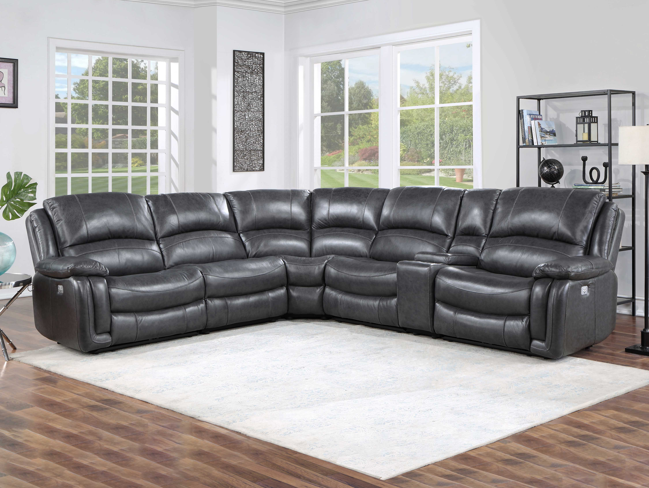
Denver
A generously scaled showstopper. Denver is draped in a luxurious charcoal leather. Transitional styling and power headrest and footrest means you can relax and enjoy the show! And modular seating means you can build the set to fit your space exactly.
Dual-Power (Power Headrest and Power Footrest)
Modular Configuration to easily fit any space
Plush wide seating area
USB charging port
Console features hidden storage and two cupholders
Charcoal leather on fronts with vinyl on sides and back
Available as Mixable Truckload Purchase only
Item | Description | Cubes | WH Price
DN5691LRC | Denver LAF Recliner Charcoal, Power/Power, 40.5"x40"x40" | 30.28 | $490.00
DN5691RRC | Denver RAF Recliner Charcoal, Power/Power, 40.5"x40"x40" | 30.28 | $490.00
DN5691ARC | Denver Armless Recliner Charcoal, Power/Power, 32"x40"x40" | 24.08 | $390.00
DN5691ACC | Denver Armless Chair Charcoal, 32"x40"x40" | 24.08 | $240.00
DN5691WC | Denver Corner Wedge Charcoal, 45.5"x45.5"x40" | 38.48 | $339.00
DN5691CC | Denver Straight Console Charcoal, Electric, 13"x40"x40" | 10.21 | $150.00
6 Piece | Denver Sectional w/3 Power/Power Recliners | 157.41 | $2,099.00

Slide 12
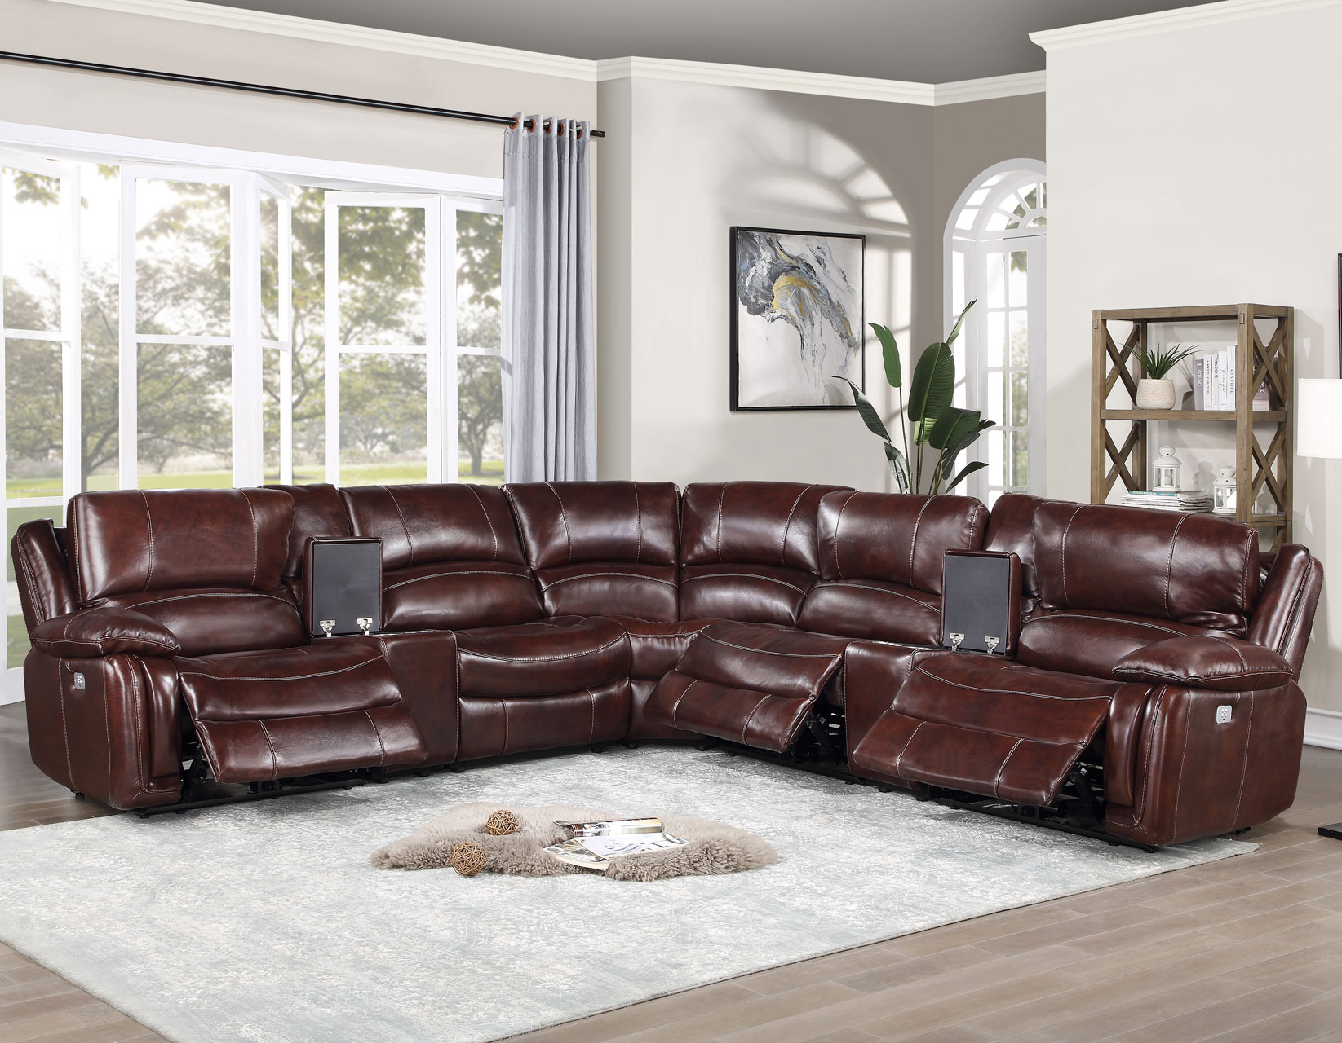
Denver
Item | Description | Cubes | WH Price
DN5691LRB | Denver LAF Recliner Brown, Power/Power, 40.5"x40"x40" | 30.28 | $490.00
DN5691RRB | Denver RAF Recliner Brown, Power/Power, 40.5"x40"x40" | 30.28 | $490.00
DN5691ARB | Denver Armless Recliner Brown, Power/Power, 32"x40"x40" | 24.08 | $390.00
DN5691ACB | Denver Armless Chair Brown, 32"x40"x40" | 24.08 | $240.00
DN5691WB | Denver Corner Wedge Brown, 45.5"x45.5"x40" | 38.48 | $339.00
DN5691SCB | Denver Straight Console Brown, Electric, 13"x40"x40" | 10.21 | $150.00
6 Piece | Denver Sectional w/3 Power/Power Recliners | 157.41 | $2,099.00
A generously scaled showstopper. Denver is draped in a luxurious merlot leather. Transitional styling and power headrest and footrest means you can relax and enjoy the show! And modular seating means you can build the set to fit your space exactly.
Dual-Power (Power Headrest and Power Footrest)
Modular Configuration to easily fit any space
Plush wide seating area
USB charging port
Console features hidden storage and two cupholders
Merlot leather on fronts with vinyl on sides and back
Available as Mixable Truckload Purchase only

